Slide 1
IMDb Box Office Analysis
Gayatri Reddiar
Sahil Bagwan
Aditya Salunkhe

Slide 2
Data Sources
IMDb
IMDb BoxOfficeMojo
MovieLens
Numbers

Slide 3

Tools Used
ER Studio
Talend
PowerBI
Tableau

Slide 4
IMDb Table Row Counts
Table Name | Table Row Count
dim_imdb_brand | 44
dim_imdb_Franchise | 949
dim_imdb_genres | 48
dim_imdb_genres_ml_rejects | 138
dim_imdb_job_category | 12
dim_imdb_name_basics | 10,008,408
dim_imdb_name_basics_knownForTitles | 21,565,259
dim_imdb_name_basics_knownForTitles_rejects | 10,039
dim_imdb_name_basics_primaryProfession | 10,986,452
dim_imdb_primaryProfession | 40
dim_imdb_title_akas | 21,609,393
dim_imdb_title_akas_rejects | 5,224
dim_imdb_title_basics | 6,704,790
dim_imdb_title_basics_genres | 10,270,794
dim_imdb_title_basics_ml_rejects | 78
dim_imdb_title_crew_directors | 5,170,597
dim_imdb_title_crew_directors_rejects | 31
dim_imdb_title_crew_writers | 7,916,672
dim_imdb_title_crew_writers_rejects | 30
dim_imdb_title_episode | 4,764,372
dim_imdb_title_episode_rejects | 10
dim_imdb_title_principals | 38,676,545
dim_imdb_title_principals_rejects | 22,607
dim_imdb_titleType | 10
dim_iso_country | 249
dim_iso_language | 486
fct_imdb_brands_gross | 44
fct_imdb_brands_list | 629
fct_imdb_franchises_gross | 289
fct_imdb_franchises_list | 281
fct_imdb_title_ratings | 1,023,897
fct_ml_genome_scores | 15,560,760
fct_ml_genome_scores_rejects | 23,688
fct_ml_genome_tags | 1,128
fct_ml_ratings | 24,983,941
fct_ml_ratings_rejects | 16,154
fct_ml_tags | 1,092,751
fct_ml_tags_rejects | 609
fct_movies_box_office_worldwide | 1,000
fct_numbers_daily_box_office | 97
fct_numbers_franchise_all_box_office | 867
fct_numbers_franchise_movies_box_office | 28

Slide 5

DATA CLEANING & STAGING
The data from IMDb, BoxOfficeMojo, MovieLens and Numbers are loaded into the respective stage tables
Data is cleaned before loading it into stage tables in Talend

Slide 6
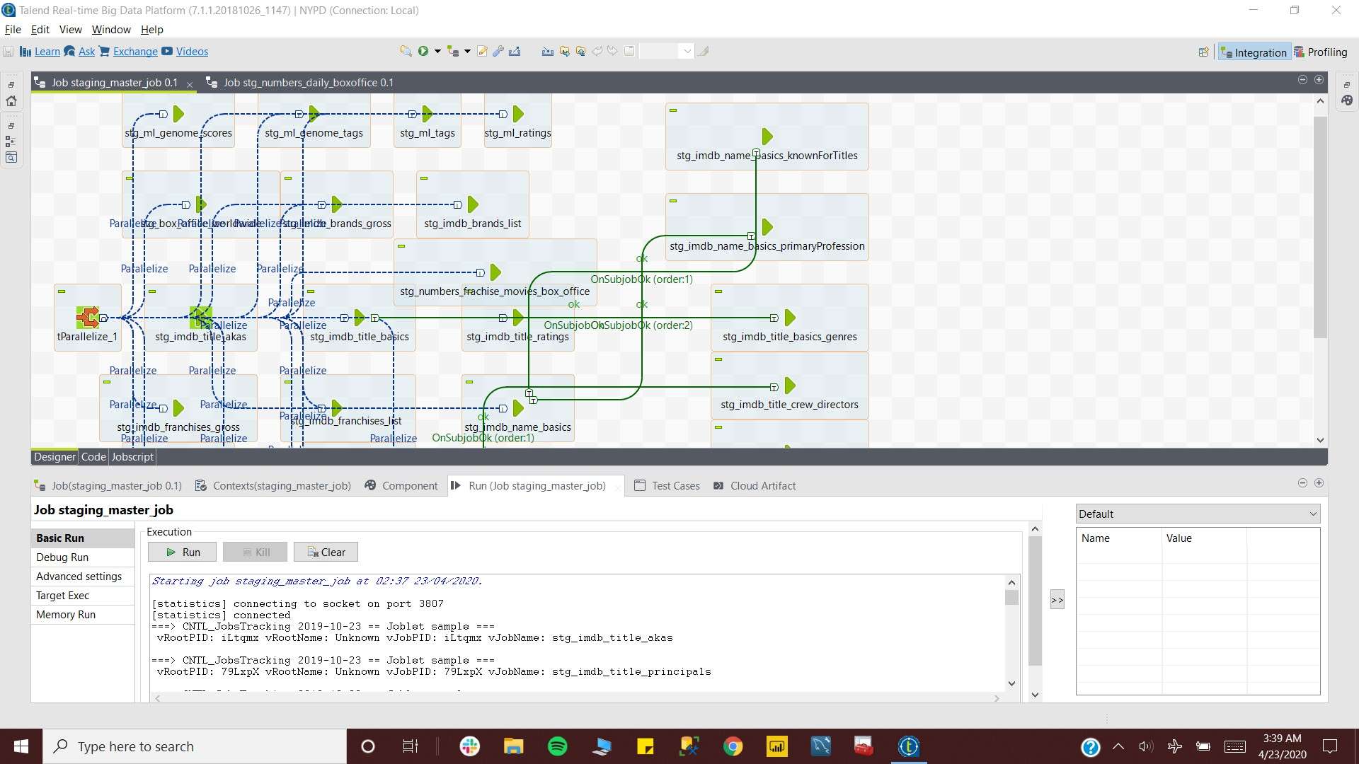

Slide 7
DIMENSIONAL MODEL
A dimensional model is prepared based on the stage tables highlighting the various facts and dimensions in the IMDb and other datasets
The model is used to generate a physical model and subsequent DDL script for building the IMDb data warehouse.

Slide 8
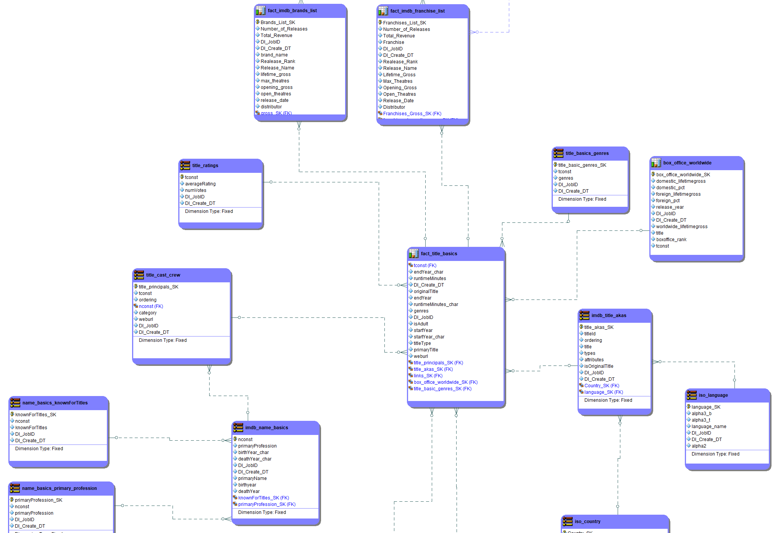
Dimensional Model

Slide 9
DATA INTEGRATION
Once the staging tables have been loaded and dimensional model created, the dimension and fact tables are loaded as part of the Data Integration Process.
A master job is created which parallelizes the different jobs and loads data into the IMDb database

Slide 10
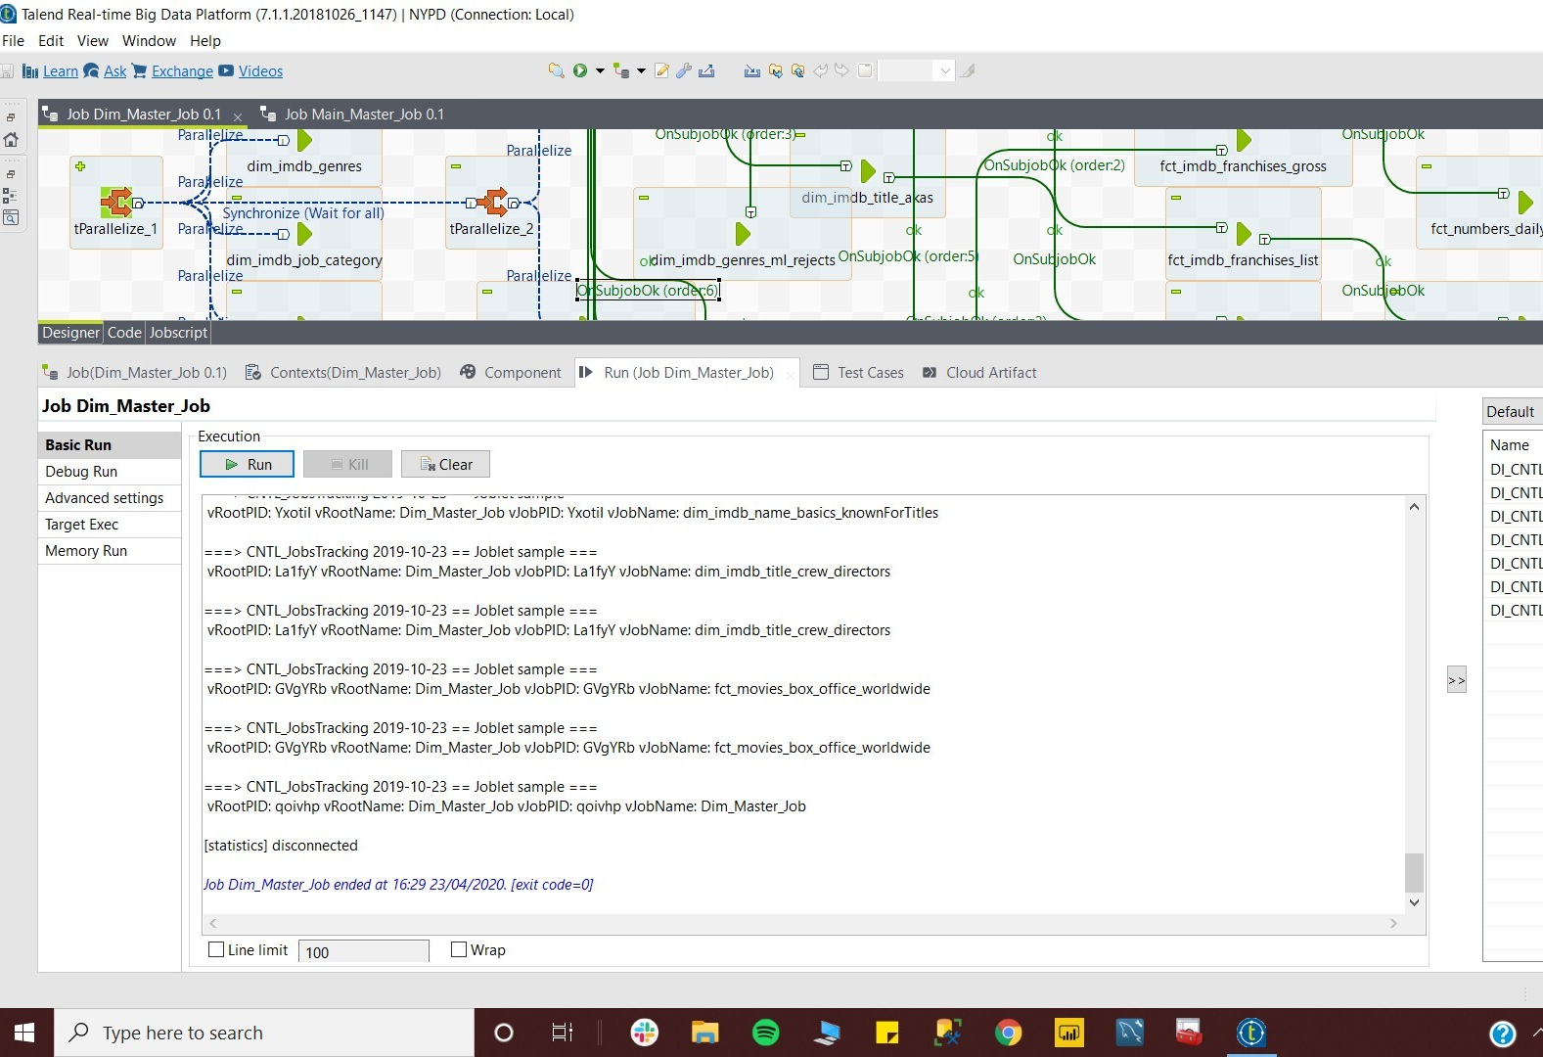
Master Job

Slide 11
VISUALISATION
Top 100 movies – Worldwide BoxOffice Gross Revenue
Top 25 IMDb movies – Number of Votes and Average Ratings
Top 25 Movie Lens movies – Average Ratings
IMDb Movies - actors, actresses, writers and directors

Slide 12
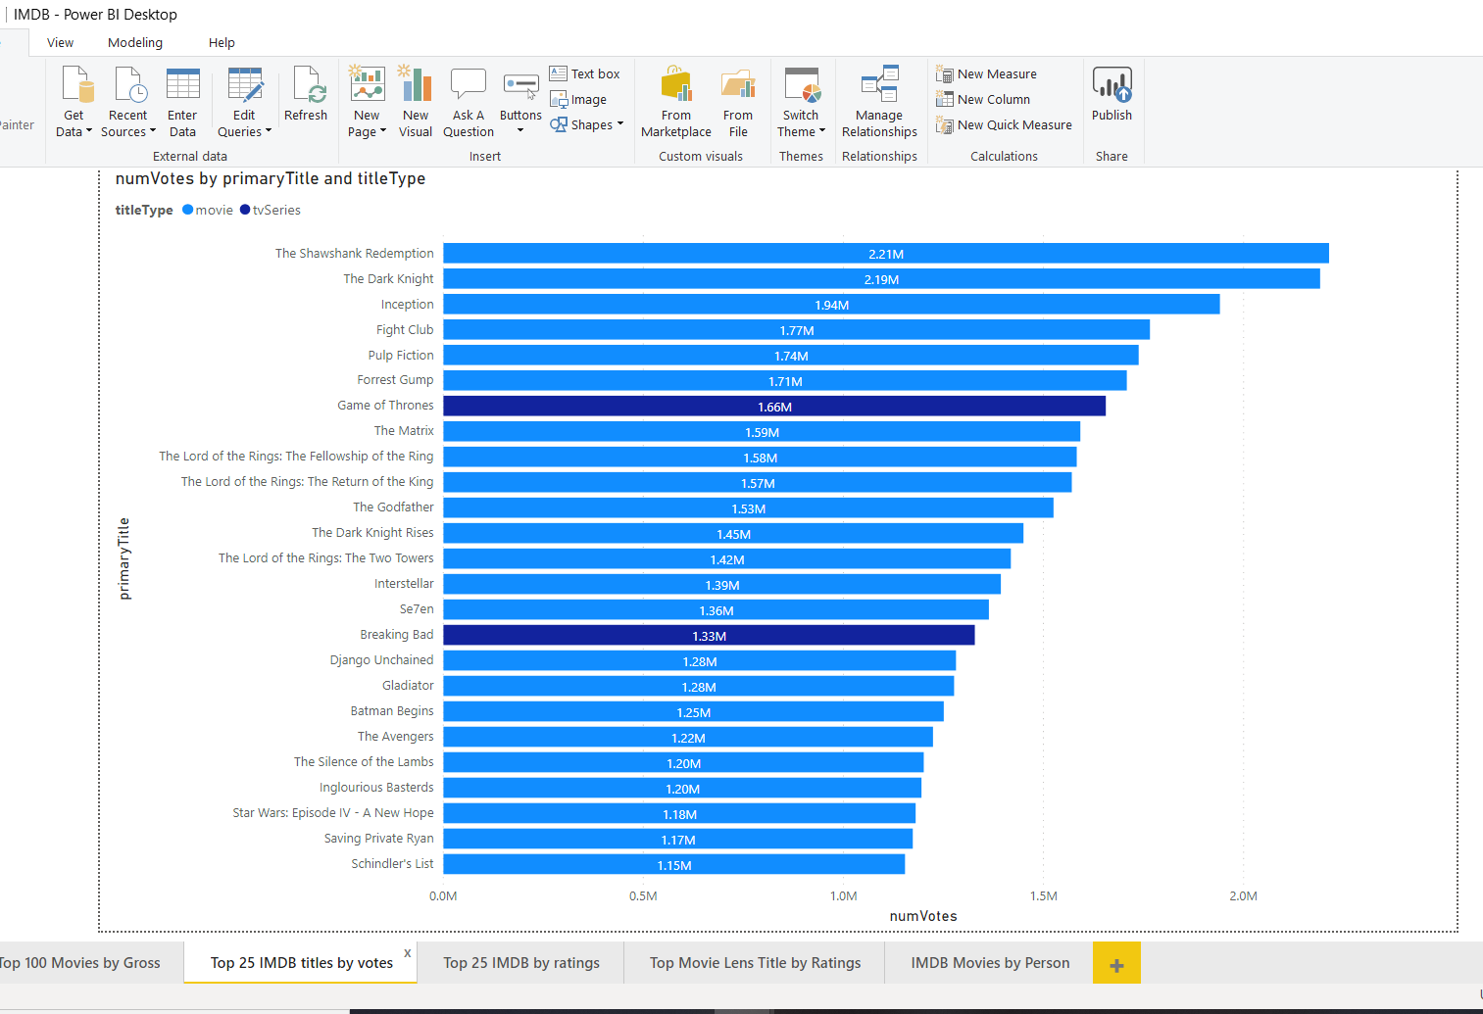
Top 25 IMDb movies – Number of Votes

Slide 13
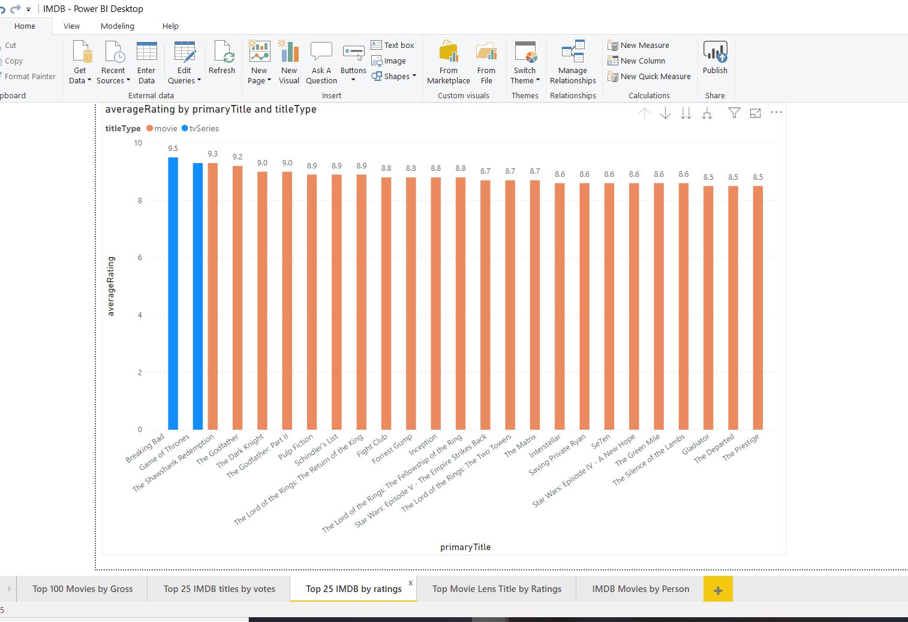
Top 25 IMDb movies – Average Ratings

Slide 14
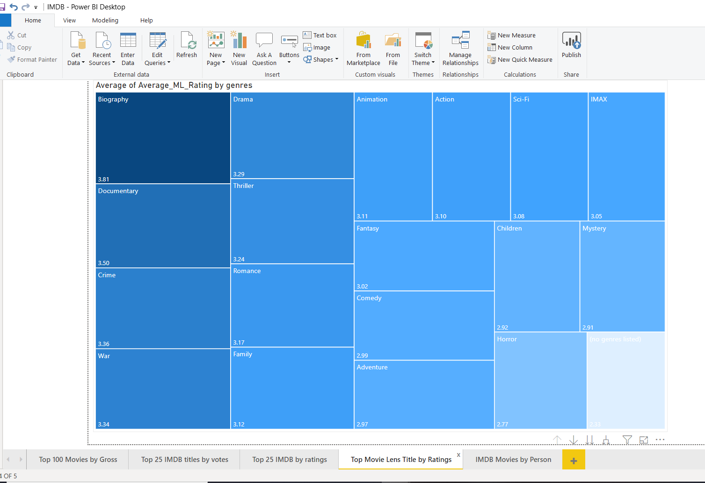
Top 25 Movie Lens movies – Average Ratings

Slide 15
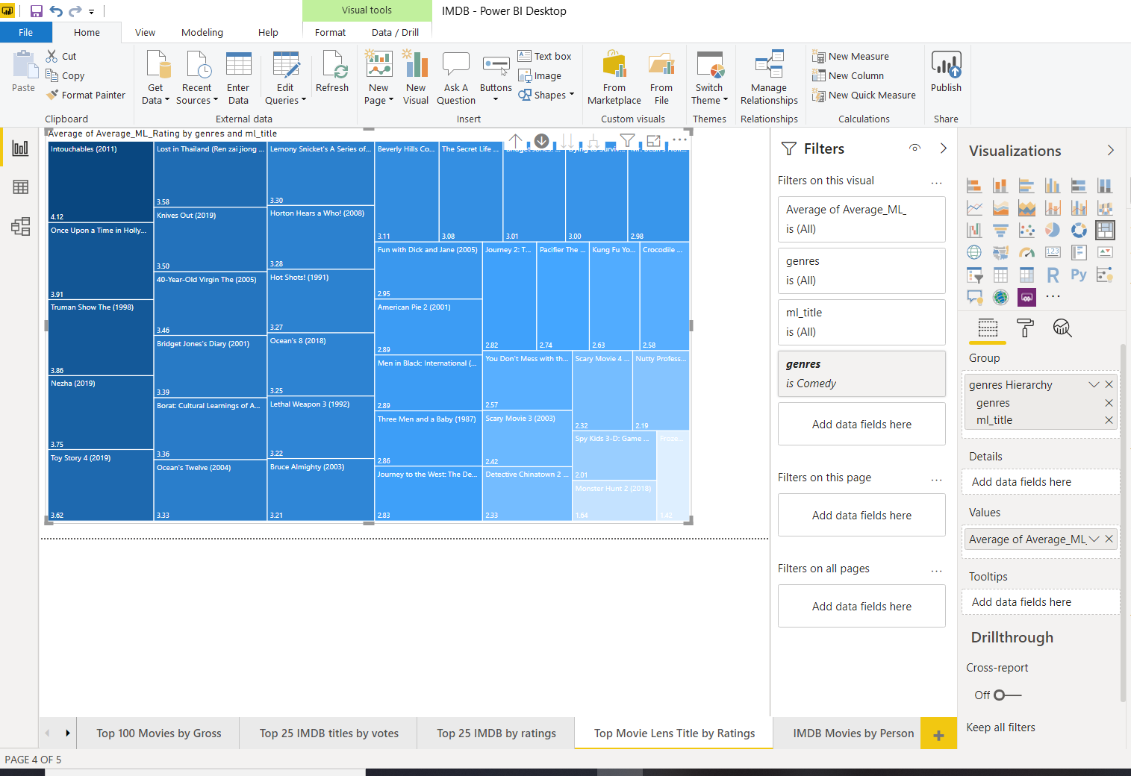
Top 25 Movie Lens movies – Average Ratings

Slide 16
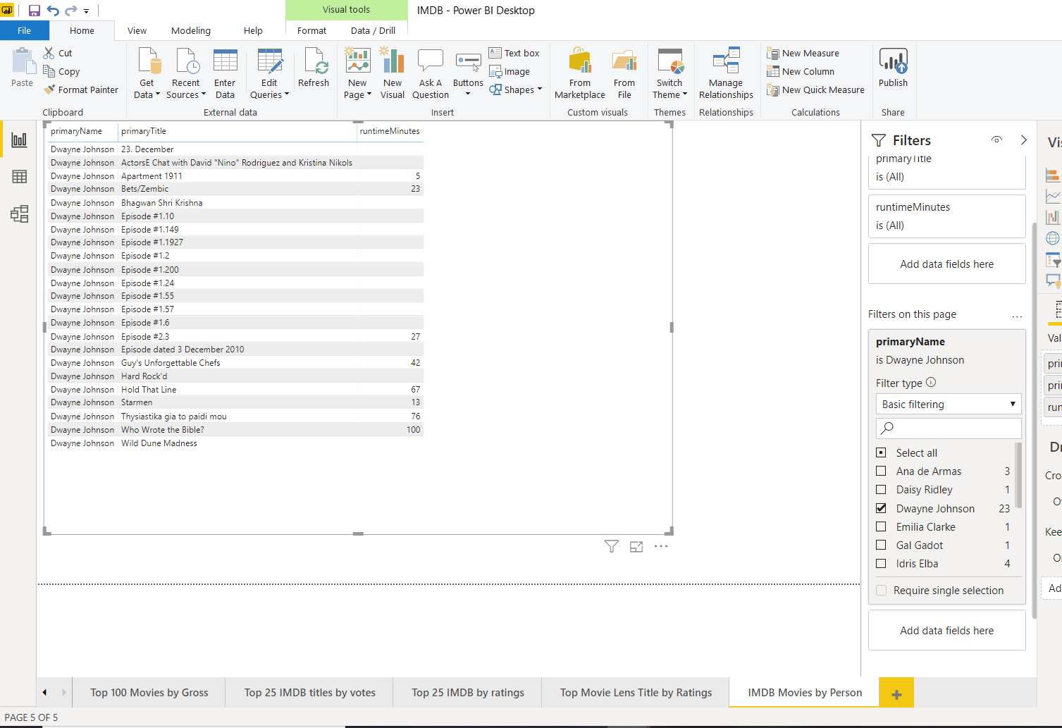
IMDb Movies - actors, actresses, writers and directors

Slide 17
TABLEAU BUSINESS ANALYSIS
Average Rating Vs Number of Votes
Domestic Vs Foreign Worldwide Gross Share
Country Wise Gross Share

Slide 18
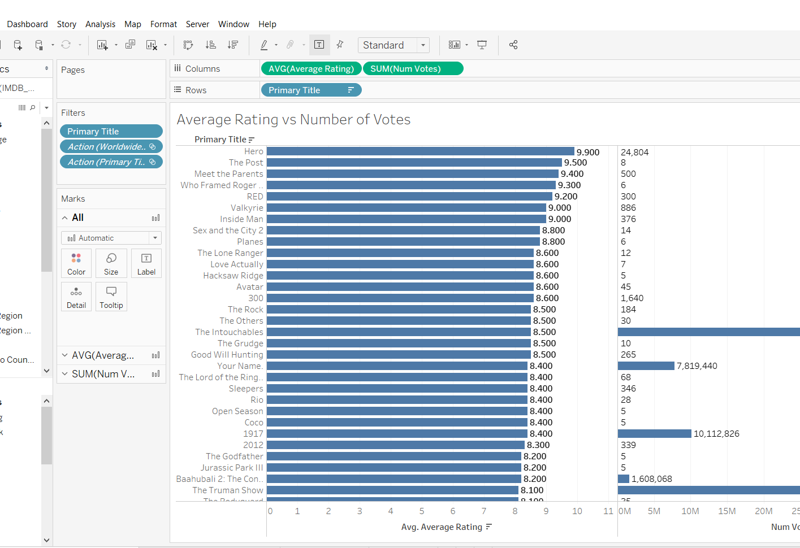
Average Rating Vs Number of Votes

Slide 19
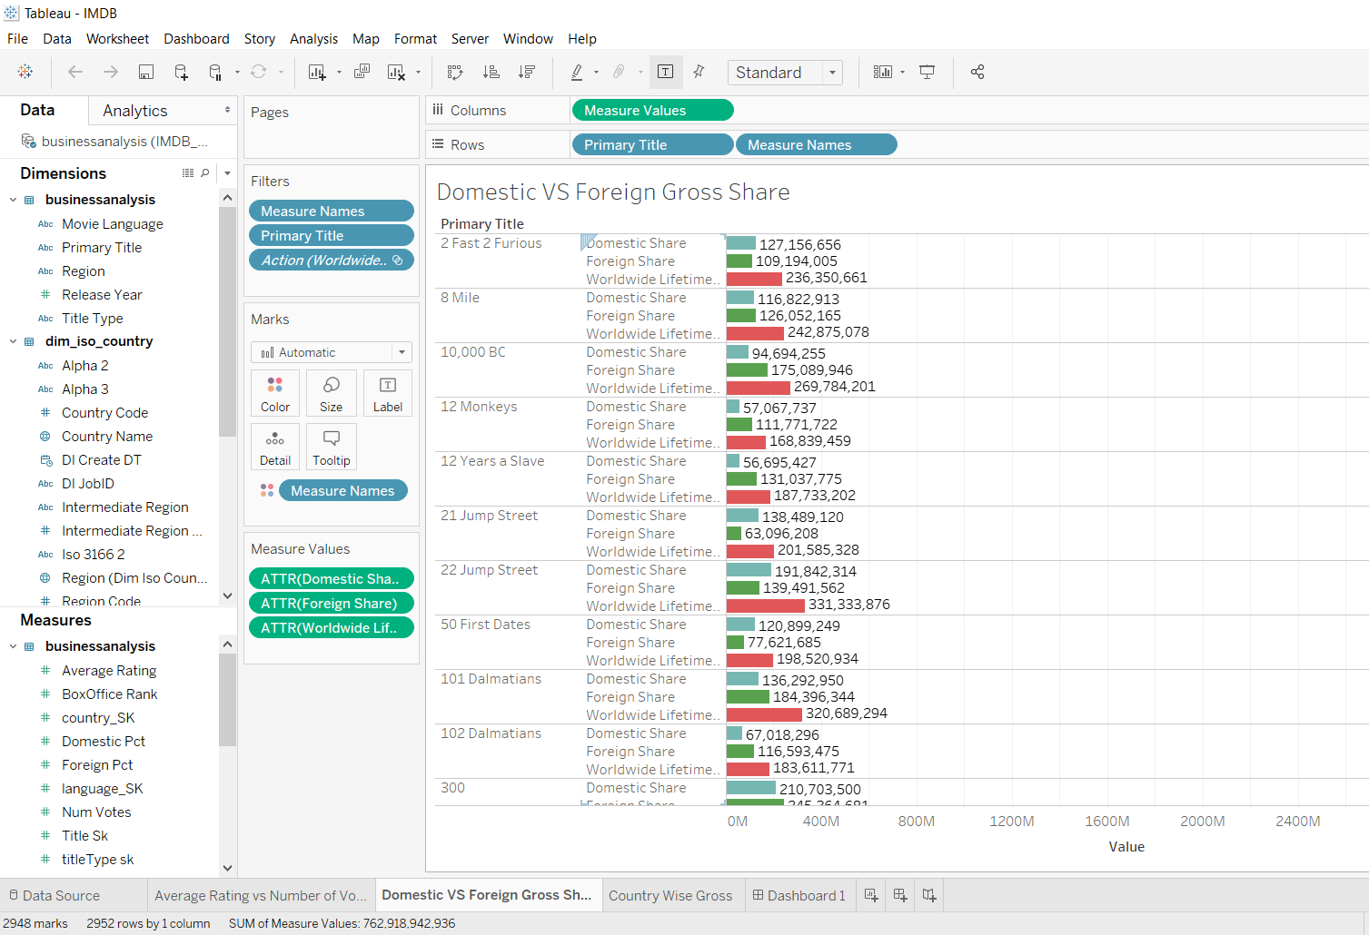
Domestic Vs Foreign Worldwide Gross Share

Slide 20
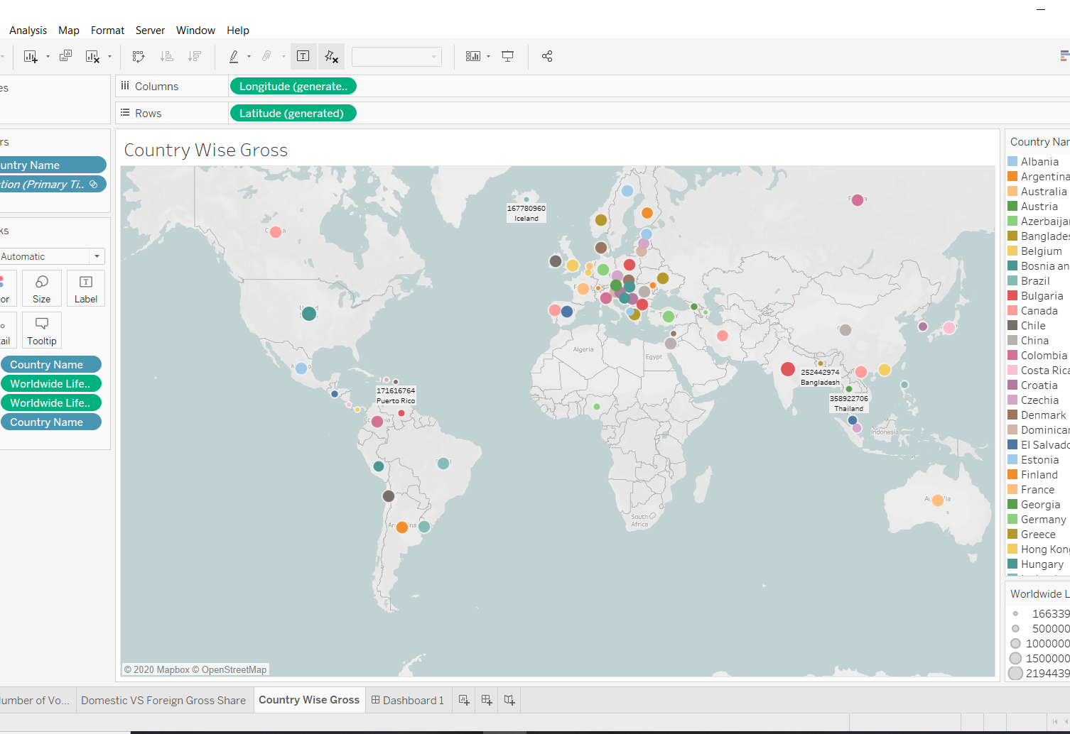
Country Wise Gross Share

Slide 21
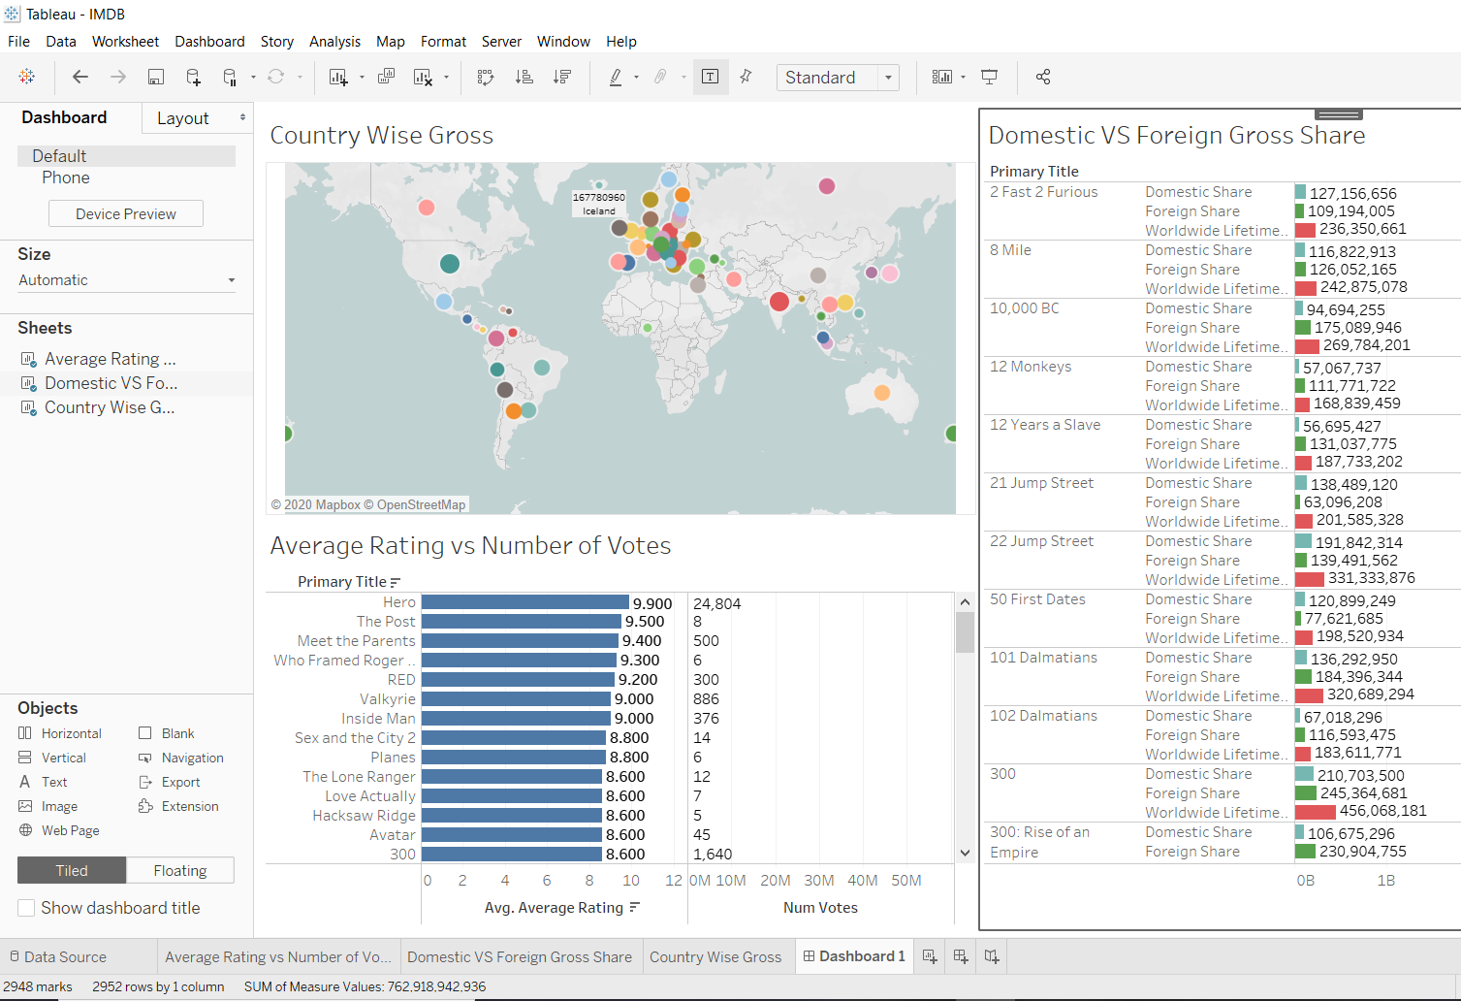
Dashboard – Business Analysis

